Slide 1
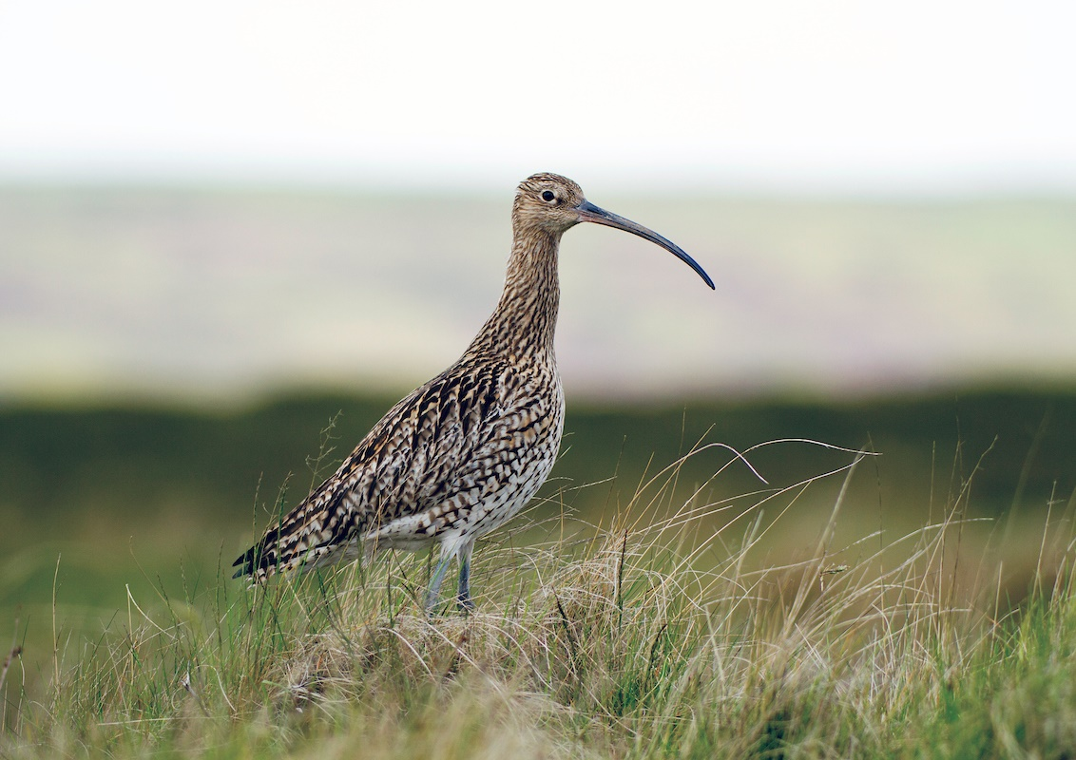
Curlews
Let’s talk about
Photo ©Harding Birdwatch Ireland

Slide 2

RED STATUS
The Curlew, one of Ireland's most iconic birds, and
is also one of our most endangered bird species
In the 1980's there were about 3,500 - 5,500 pairs of breeding curlew in Ireland. A study carried out between 2012-2017 by the National Parks and Wildlife Service (NPWS), found that only 148 remain.
The Curlew Conservation Programme was established in 2017 to save Ireland's last breeding Curlew.
Illustration © LIVE

Slide 3
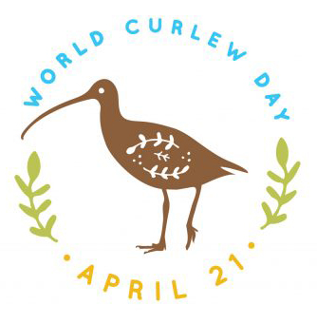
World Curlew Day
Curlews have inspired poets, artists, musicians and writers
for generations. Their iconic call could be heard in coasts, meadows, mountain slopes and moorlands. Sadly, there are fewer and fewer breeding curlews every year.
World Curlew Day falls on the 21st April each year. It’s a special day to help raise awareness about curlews, so we learn more about them, in the hope that we can save these beautiful birds from extinction.
Let's find out more about Curlews and World Curlew Day!
Illustration © World Curlew Day

Slide 4
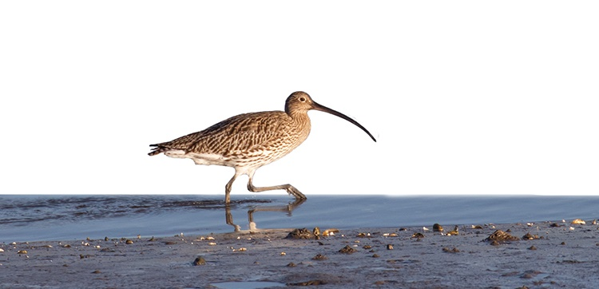
Ireland’s Largest Waders
The Curlew is Ireland's largest wader. A wader is a long-legged bird that 'wades' in shallow water or muddy ground to look for food. In Munster Irish, we say Cuirliún, but you can also say Crotach.
Photo © Ben Porter

Slide 5
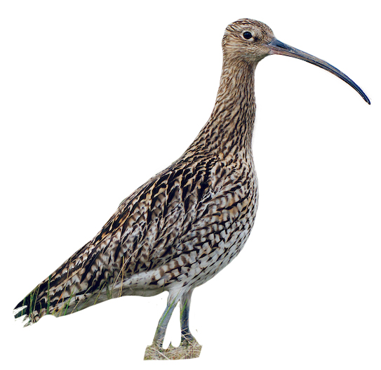
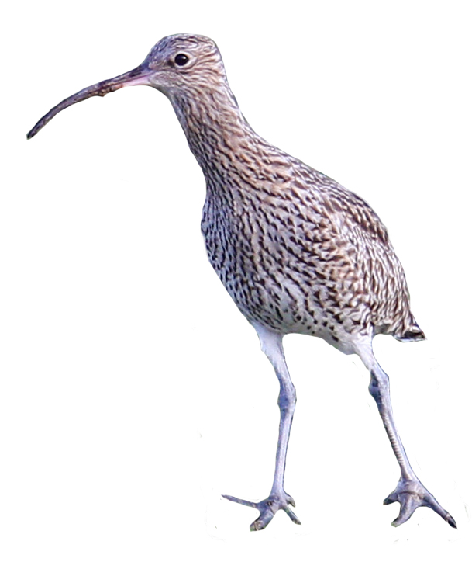
What does a Curlew look like?
Curlews are a large, mostly greyish brown (speckled dark and light) bird, with long greyish blue legs, long dark beak and long neck. The underbelly is more of a creamy colour, lightly speckled.
Long beak
Long neck
Long legs
Photo © Harding Birdwatch Ireland
Photo © Ben Porter

Slide 6
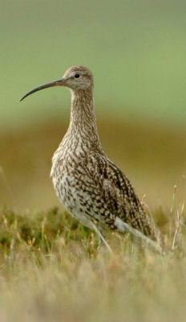
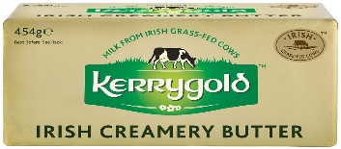
How big is a curlew?
A curlew can measure up to 60cm tall. That’s the length of 2 normal school rulers!
They can weigh between 600g
and 950g. That’s between 1.5 lbs and 2 lbs of butter!
907g
600g
454g
Photo © Birdwatch Ireland

Slide 7
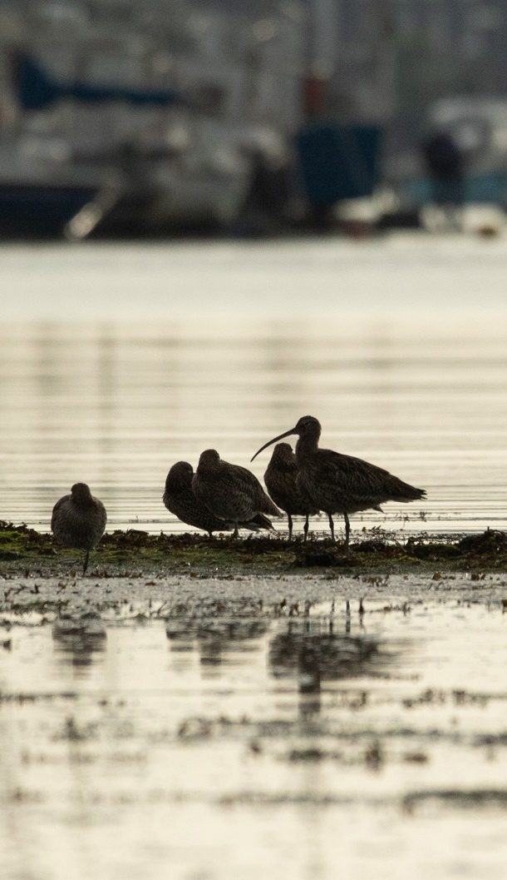
What does a curlew sound like?
Curlews are most well-known for their distinctive ‘bubbling’ call:
‘kur-leeee – kur-leee – kur-leee’
Have a listen to curlew sounds here:
Photo © Ben Porter

Slide 8
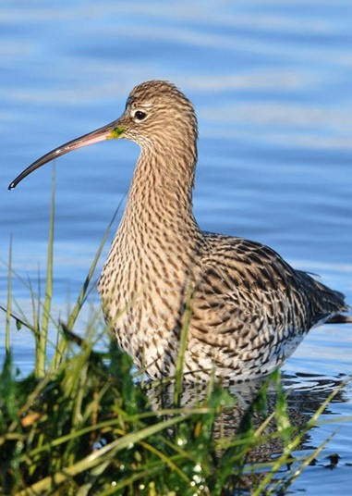
Where do Curlews like to live?
Curlews like to lay their eggs in bogs and meadows in the spring and summer.
In autumn and winter, they feed in wetland areas such as estuaries, tidal shores and nearby fields or greens.
Photo © Birdwatch Ireland

Slide 9
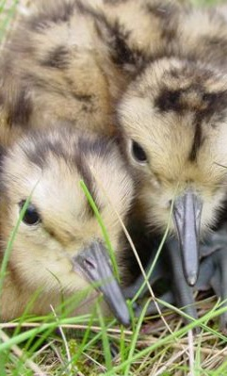
Why do Curlews like to live in bogs and meadows?
Curlews, like many other wading birds, make their nests on the ground.
Hidden in long grass, these nests are well camouflaged, and the chicks can feed and hide in the area when they hatch.
Photo © Insley Birdwatch Ireland

Slide 10
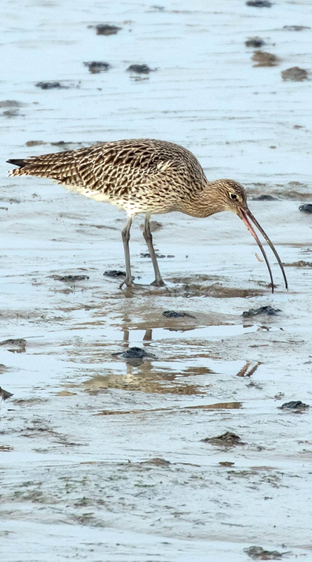
What do Curlews like to eat?
Curlews like to eat worms, caterpillars, crabs, shrimps, spiders, insects, and other types of creepy crawlies.
Photo © Ben Porter

Slide 11
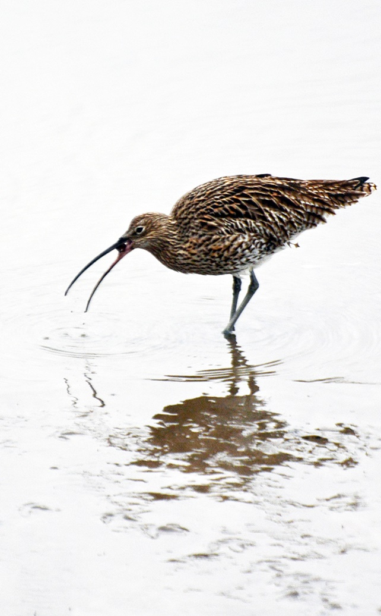
Why do Curlews have long beaks?
Curlew's have a very long beak (also called a bill). This helps them find food in soft ground, wet mud and shallow water.
The end of a curlew’s bill is sensitive and acts like tweezers which enables it to feel around in the mud for food.
Photo © Linda Lyne

Slide 12
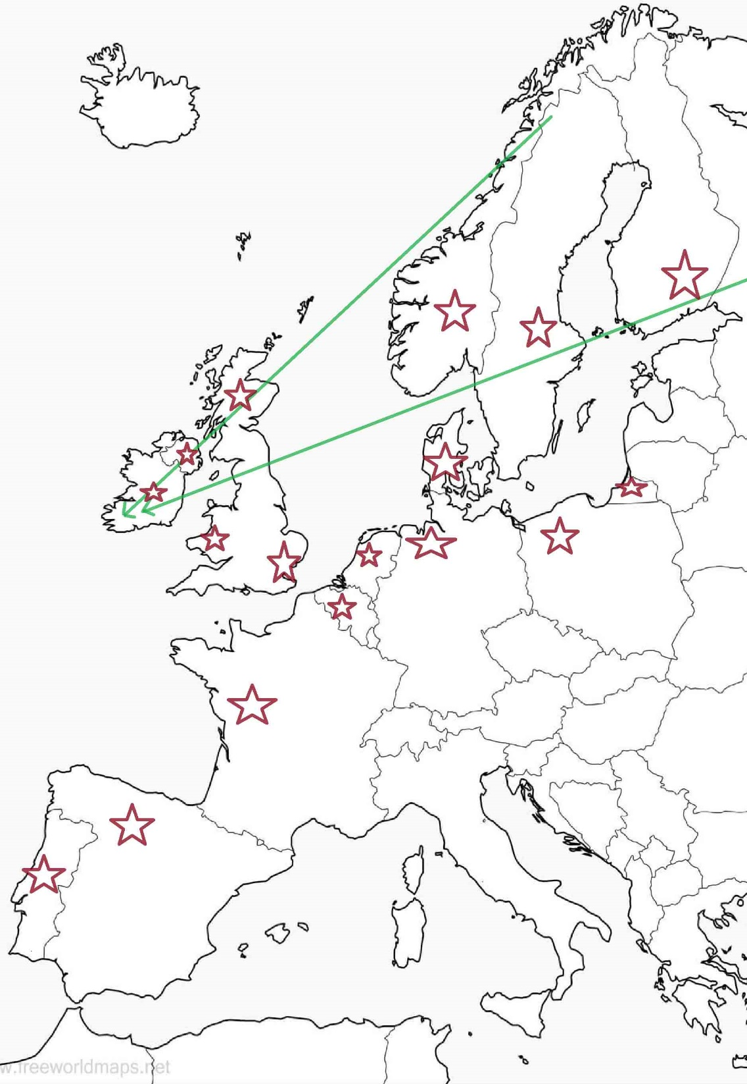
Curlew Migration
Curlews are migratory birds - they leave their breeding grounds with their young soon after they learn to fly, typically from the end of July.
Birds nesting in Scandinavia and Russia migrate to Western Europe’s milder climates for the winter. Curlews are present all year in Ireland and Britain and the nearby European coasts.
Photo © FreeWorldMaps

Slide 13
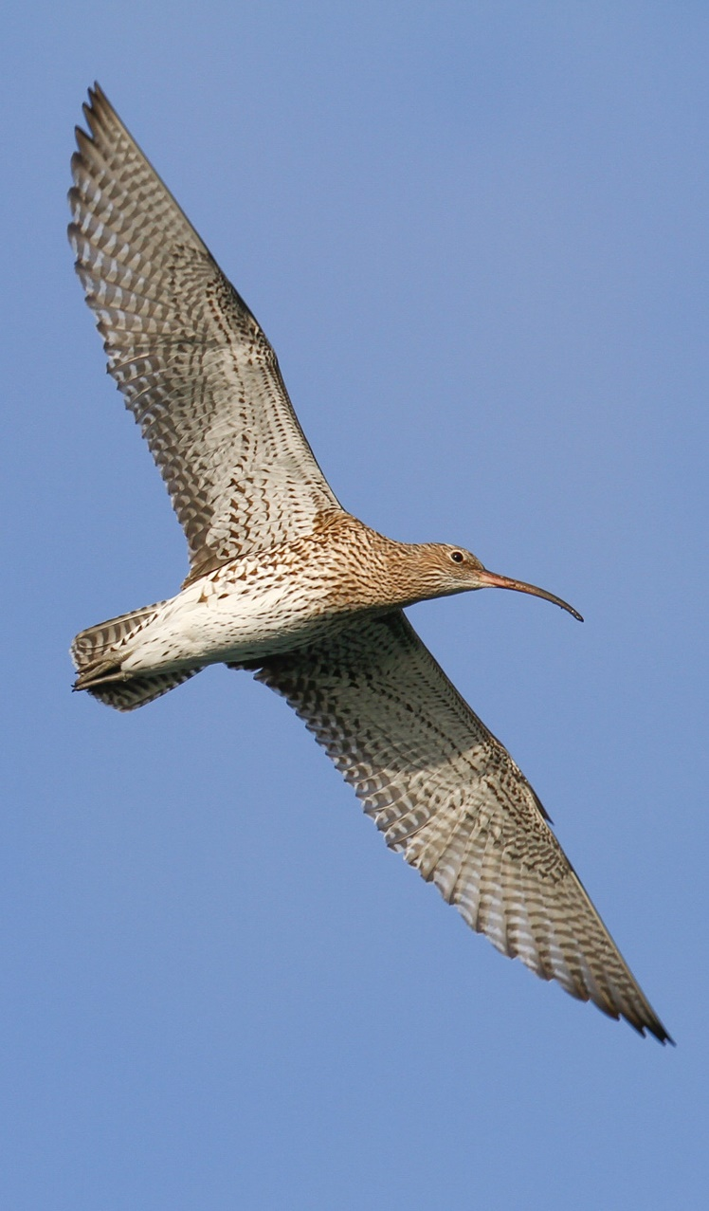
Curlews in Ireland
Most curlews that you see in winter in Ireland have arrived here from colder northern climates to feed during our milder winters.
They stay from September to April. These curlews migrate back to their countries to have their chicks.
Photo © Ben Porter

Slide 14
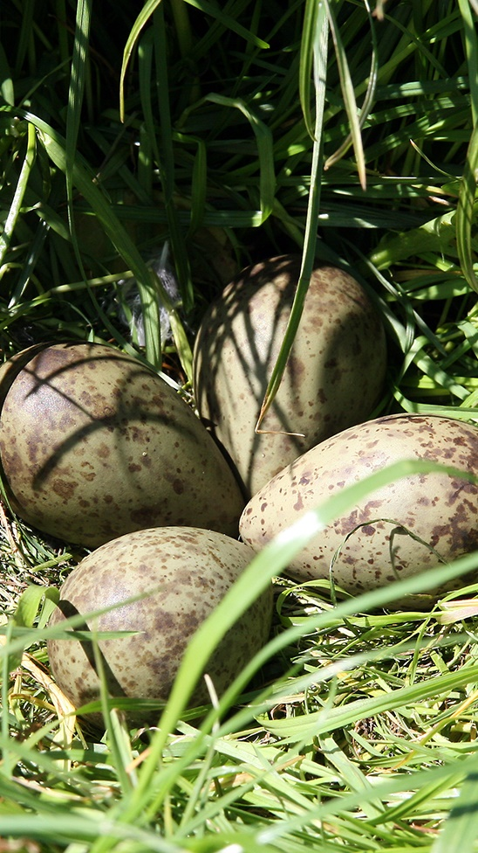
Irish Breeding Curlews
Irish breeding curlews are very rare and very important! They stay here to breed and will lay their eggs in mid-April.
Curlews usually lay 4 eggs in ground nests. They are about the same size as hen eggs. They are usually light green, and speckled brown to help blend in/camouflage into the grasses.
Photo © Curlew County

Slide 15
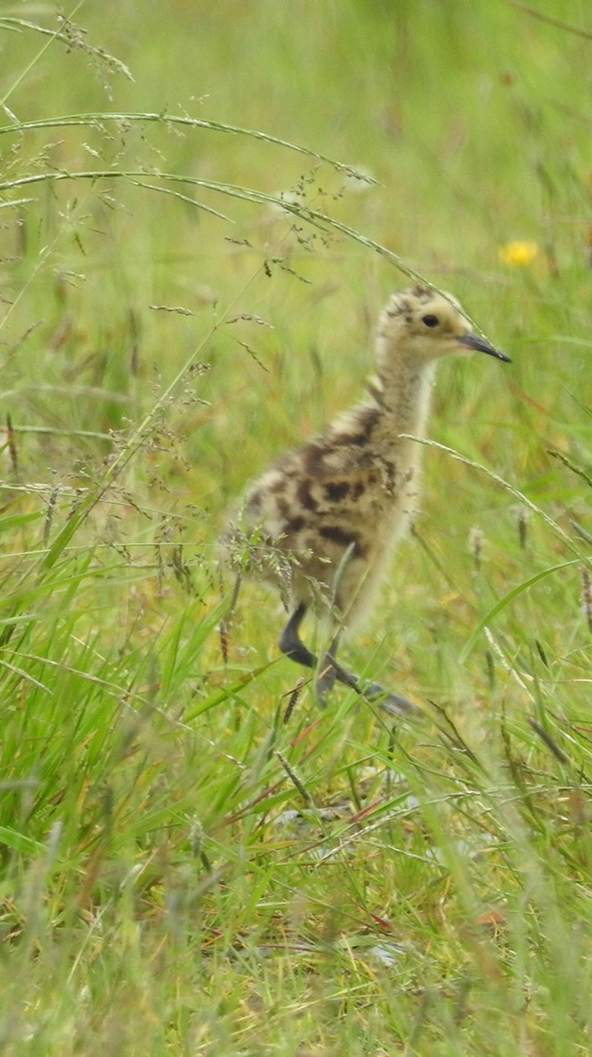
Curlew chicks
Once hatched, chicks leave the nest within a day or so and feed themselves. Damp ground and shallow pools are ideal places for chicks to feed. They are usually full of insects and worms in summer months.
Curlews leave their breeding ground with their young, soon after they learn to fly, typically from the end of July.
Photo © Joe Shannon

Slide 16
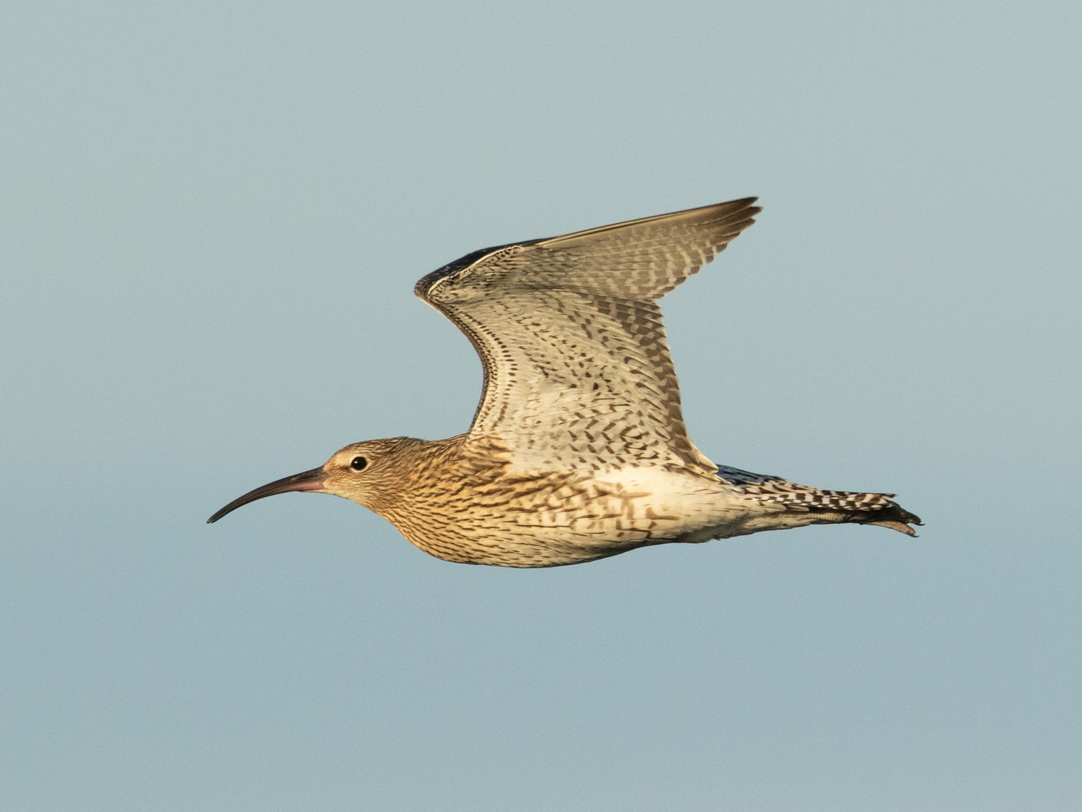
Curlews
Lets have fun with
Now that we have learned all about curlews, let's have some fun!
Photo © Ben Porter

Slide 17
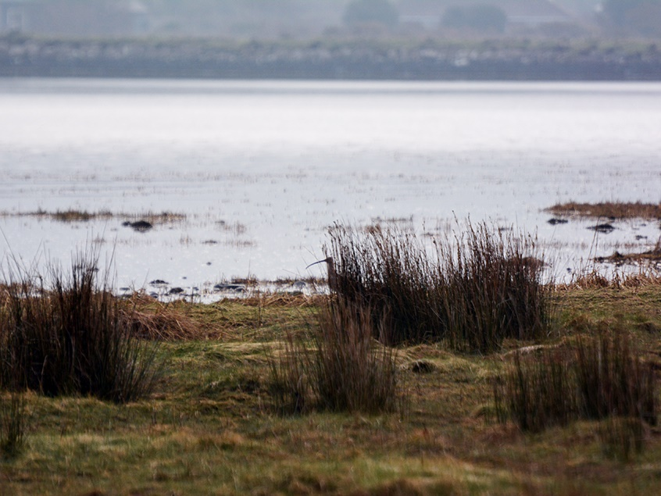
Can you find the Curlew in this picture?
Photo © Linda Lyne\

Slide 18
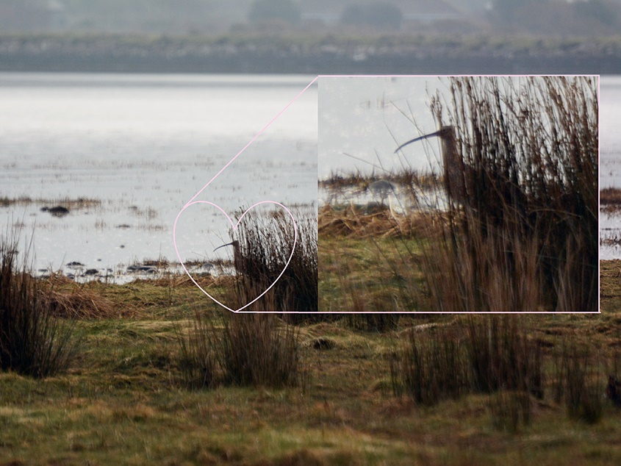
Well done!
Photo © Linda Lyne

Slide 19
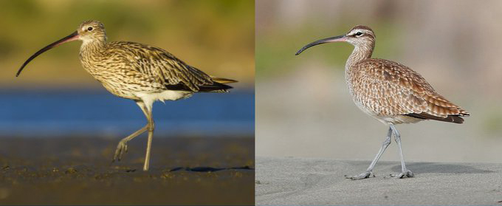
Spot the difference
The curlew and whimbrel are both large, brown waders with long, down curved bills. Distinguishing them can be tricky from a distance. Can you spot any differences?
Curlew
Whimbrel
Photos © Birdwatch Ireland

Slide 20
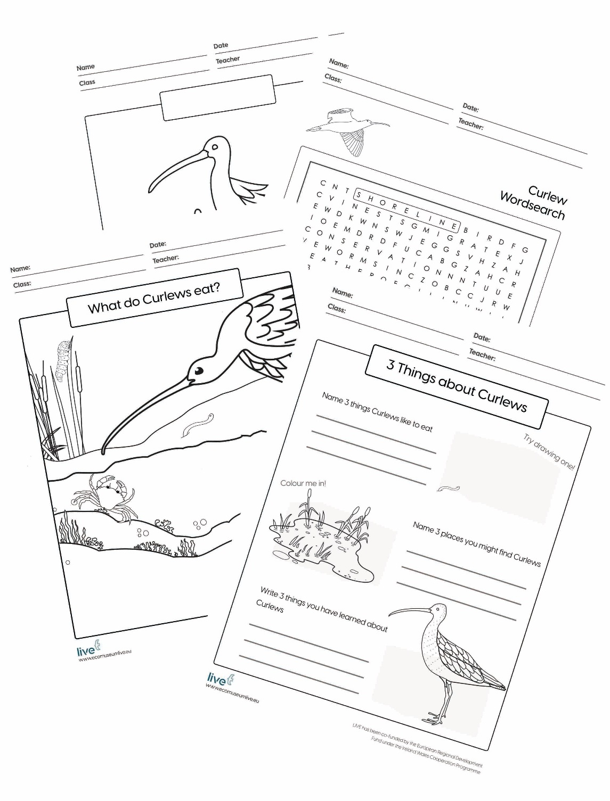
Curlew Activity Sheets!
Have some fun using our Curlew worksheets. Simply download and print
Colour in a Curlew
Can you name the different parts of a curlew?
Colour in this curlew mother with her chicks
What do Curlews eat?
Three Things about Curlews
Curlew Wordsearch
Curlew Poetry
Spot the Difference
Illustration © LIVE

Slide 21
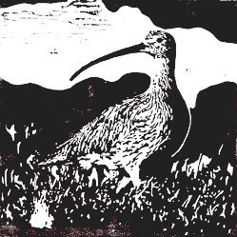


Share your curlew drawings, poems and more with us!
You can email them to live@ucc.ie, or post online on
21st April, for World Curlew Day.
For more information visit www.ecomuseumlive.eu
#WorldCurlewDay #IrishCurlews #EcomuseumLive #Cuirliún
This Curlew presentation was developed for World Curlew Day as part of The LIVE Project's environmental education programme with the assistance of the Curlew Conservation Programme. The LIVE Project is co-funded by the European Regional Development fund under the Ireland Wales Cooperation Programme. This presentation and its images can be used for educational purpose only, under Creative Commons Licences.

